Slide 1


Slide 2

Notes:
Mainframe era = No testing. Code was mostly hand-written. Cards, ed, batch yuck. Manual testing FTW? sad to say mini still use this method. Unit Testing, Smalltalk 1998. TDD, Continuous Testing, Continuous Integration...

Slide 3


Slide 4
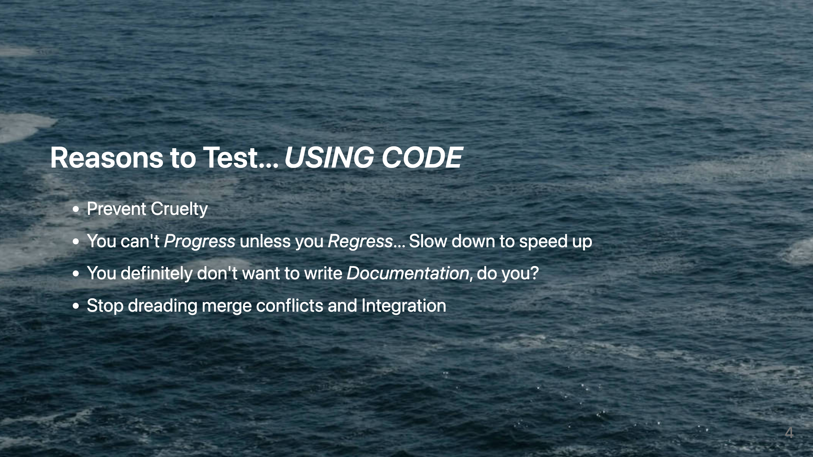
Notes:
- Asking humans to do over and over and over again what a computer could easily do is cruel. - Everyone is familiar with one of the most common anti-patterns in our industry. Everything is great at the beginning and your coding in coding but eventually everything starts to slow down. Seemingly minor changes now take forever. The tech dead just drags and drags until eventually someone comes up with a brilliant idea of a rewrite! - I have never seen a developer who likes to document. Documentation not tied to actual code always decays. - Ugh...

Slide 5
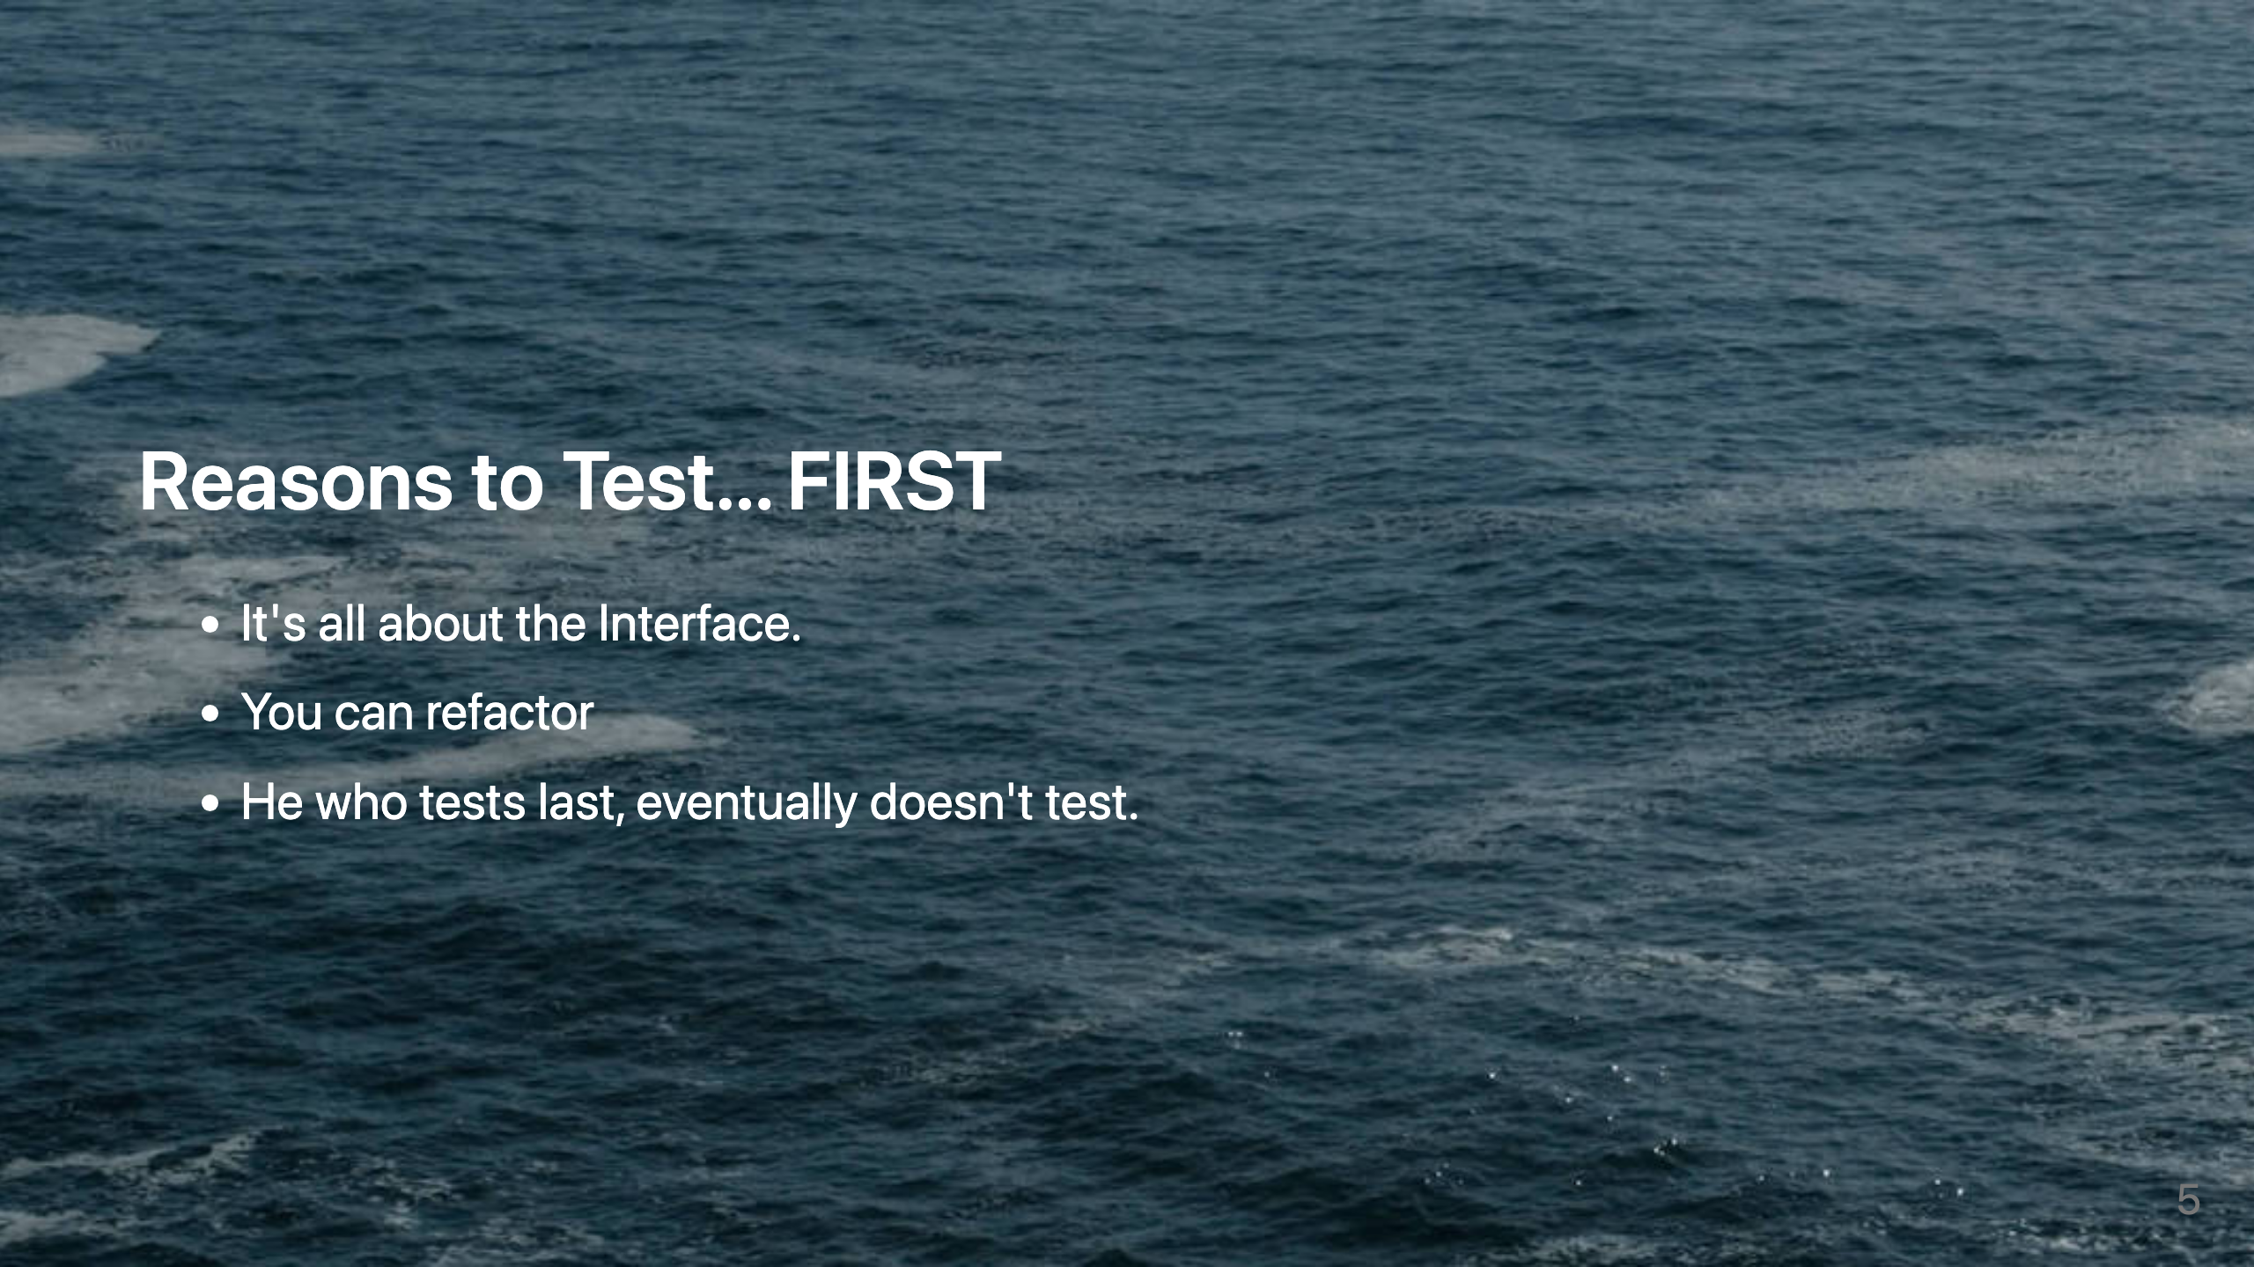
Notes:
- TDD is as much about about Design as testing. - Red / Green - Let's be honest

Slide 6

Notes:
- no more restlessly scanning code bases to make sure you didn't miss something. - know instantly that you broke something. - stop fearing the day after the release

Slide 7
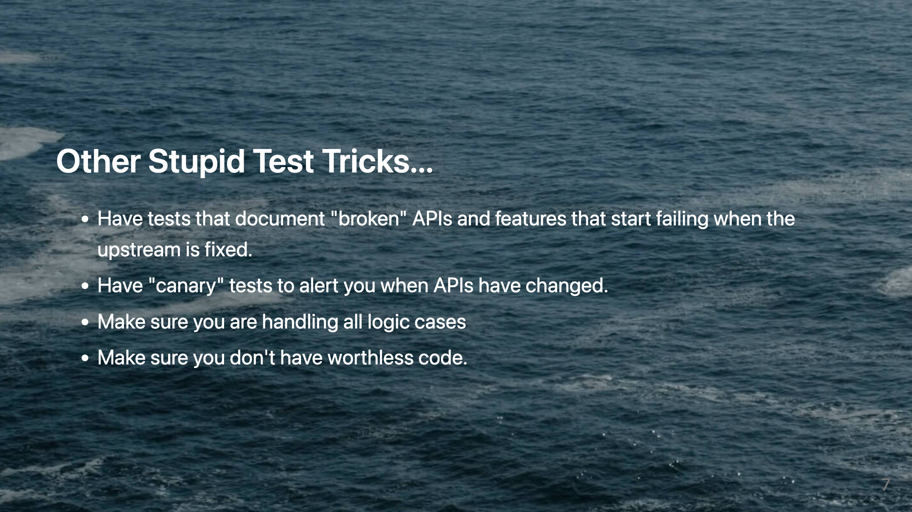
Notes:
- - - - Almost all systems of any longevity have some amount of "zombie" code. That code that no one wants to touch. They don't think that it does anything but they don't know for sure so it's better to just not touch it. You can now remove it with confidence.

Slide 8

Notes:
- Easier to reason about - No frustrating waiting. - Order of execution failures Will Drive you crazy. Many of the advanced unit testing frameworks we'll run tests in random order to catch this early. - Your tests become a spec. - Or else how do you know it's working? Especially when working with fake send marks it's easier than you think to write a test that never fails.

Slide 9

Notes:
You just get more information from the former. Another Smalltalk Best Practice pattern. This is just helpful in so many places. Show tests/subject/hoon Show tests/subject/categories Show tests/agent/rank/hoon Show tests/agent/rank-scry/hoon

Slide 10
